Slide 1
Descriptive Statistics
Kevin Pamilagas

Slide 2
Why Descriptive Statistics?

Slide 3

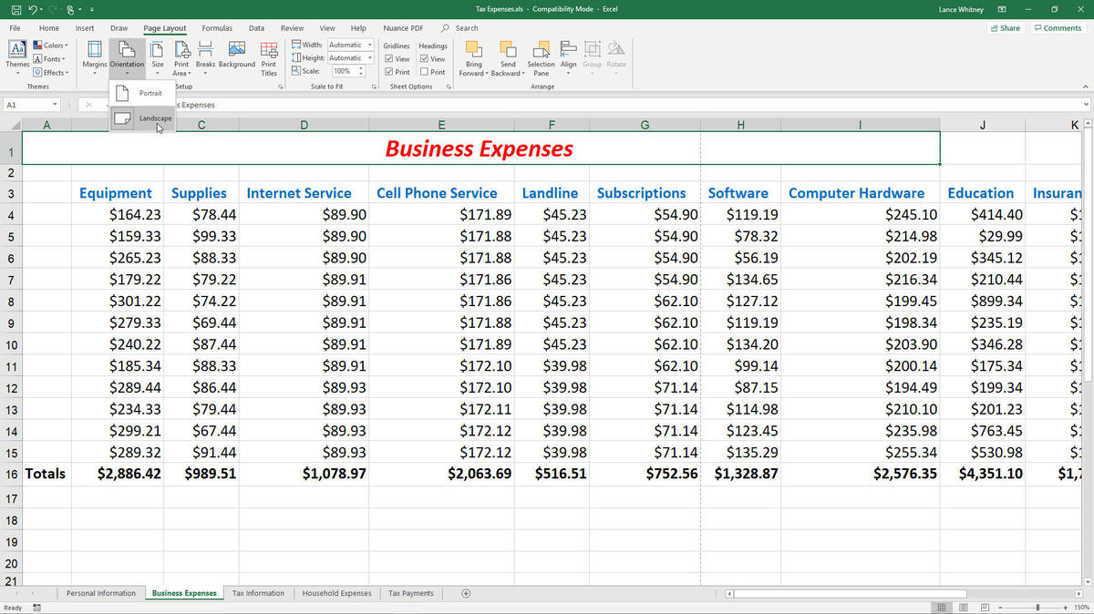
Why Descriptive Statistics?

Slide 4
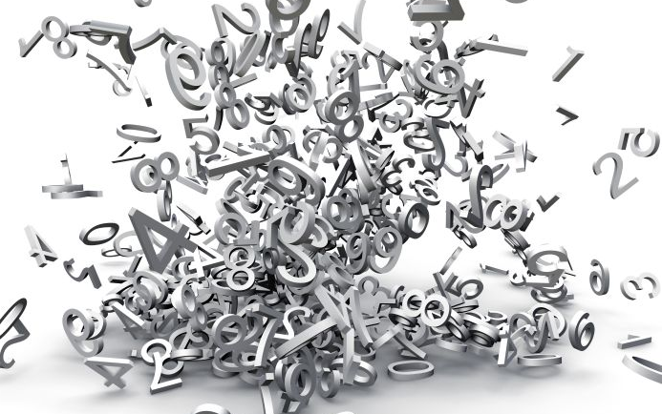
Why Descriptive Statistics?

Slide 5
Descriptive Statistics
“Descriptive statistics implies a simple quantitative summary of a data set that has been collected. It helps us understand the experiment or data set in detail and tells us everything we need to put the data in perspective.”
-Lyndsay T. Wilson

Slide 6
Descriptive Statistics

Slide 7
Descriptive Statistics
Measures of:

Slide 8
Descriptive Statistics
Measures of:
Central Tendency (Location)

Slide 9
Descriptive Statistics
Measures of:
Central Tendency (Location)
Dispersion (Spread)

Slide 10
Descriptive Statistics
Measures of:
Central Tendency (Location)
Dispersion (Spread)

Slide 11
Measures of Central Tendency

Slide 12
Measures of Central Tendency
“Center” of the data
Measures:

Slide 13
Measures of Central Tendency
“Center” of the data
Measures:
Mean
Median
Mode

Slide 14
Measures of Central Tendency - Mean

Slide 15
Measures of Central Tendency - Mean
“Average”

Slide 16
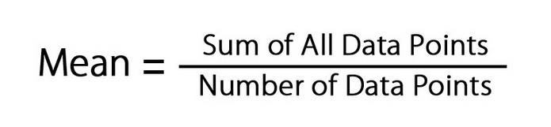
Measures of Central Tendency - Mean
“Average” =

Slide 17
Measures of Central Tendency - Mean
“Average” =
5, 1, 2, 3, 1 ,13, 8
5+1+2+3+1+13+8 7
= 4.71

Slide 18
Example
At a bike sales shop, sales reps are paid commission on every bike that he or she sells. You ask the manager what a typical sales rep is paid. The manager says the sales reps are paid a weekly commission of $2000 on average.
How could this be a concerning statement?
Notes:
Fighters: F-22(Raptor), 16(Falcon), 35(Lightning), 18(Hornet), 15(Eagle)

Slide 19
Measures of Central Tendency - Mean
$50, $50, $450, $500, $950, $1000, $11000

Slide 20
Measures of Central Tendency - Mean
$50, $50, $450, $500, $950, $1000, $11000
50+50+450+500+950+1000+11000 7
= $2000

Slide 21
Measures of Central Tendency - Median

Slide 22
Measures of Central Tendency - Median
“Middle”

Slide 23
Measures of Central Tendency - Median
“Middle”
$50, $50, $450, $500, $950, $1000, $11000

Slide 24
Measures of Central Tendency - Median
“Middle”
$50, $50, $450, $500, $950, $1000, $11000

Slide 25
Measures of Central Tendency - Median
“Middle”
$50, $50, $450, $500, $950, $1000, $11000

Slide 26
Measures of Central Tendency - Median
“Middle”
$50, $50, $450, $500, $950, $1000
$475

Slide 27
Example
$50, $50, $450, $500, $950, $1000, $11000
Mean : $2000
Median: $500

Slide 28
Example
$50, $50, $450, $500, $950, $1000, $11000
Mean : $2000
Median: $500
Mode: $50

Slide 29
Measures of Central Tendency - Mode

Slide 30
Measures of Central Tendency - Mode
“Most” frequent
$50, $50, $450, $500, $950, $1000, $11000

Slide 31
Measures of Central Tendency - Mode
“Most” frequent
$50, $50, $450, $500, $950, $1000, $11000

Slide 32
Measures of Central Tendency - Mode
“Most” frequent
$50, $50, $450, $500, $950, $1000, $11000, $500

Slide 33
Measures of Central Tendency - Mode
“Most” frequent
$50, $50, $450, $500, $950, $1000, $11000, $500
Mode: $50 & $500

Slide 34
Measures of Central Tendency - Mode
F-15 | F-15 | F-15
F-16 | F-18 | F-18
F-22 | F-22 | F-35
Notes:
Fighters: F-22(Raptor), 16(Falcon), 35(Lightning), 18(Hornet), 15(Eagle), 20(Tigershark)

Slide 35
Measures of Central Tendency - Mode
F-15 | F-15 | F-15
F-16 | F-18 | F-18
F-22 | F-22 | F-35
Mean = ~ F-19.56 Median = F-18
Notes:
Fighters: F-22(Raptor), 16(Falcon), 35(Lightning), 18(Hornet), 15(Eagle), 20(Tigershark)

Slide 36
Measures of Central Tendency - Mode
F-15 | F-15 | F-15
F-16 | F-18 | F-18
F-22 | F-22 | F-35
Mean = ~ F-19.56 Median = F-18 Mode = F-15
Notes:
Fighters: F-22(Raptor), 16(Falcon), 35(Lightning), 18(Hornet), 15(Eagle), 20(Tigershark)

Slide 37
Measures of Central Tendency - Mode
F-15 | F-15 | F-15
F-16 | F-18 | F-18
F-22 | F-22 | F-35
Mean = ~ F-19.56 Median = F-18 Mode = F-15
Notes:
Fighters: F-22(Raptor), 16(Falcon), 35(Lightning), 18(Hornet), 15(Eagle), 20(Tigershark)

Slide 38
Example
At a bike sales shop, sales rep are paid commission on every bike that he or she sells. You ask the manager what the typical sales rep is paid. The manager is not sure but provides you with the commission for seven sales reps for the past week: $500, $1000, $50, $11000, $950, $50, $450.
Notes:
Fighters: F-22(Raptor), 16(Falcon), 35(Lightning), 18(Hornet), 15(Eagle)

Slide 39
Example
$50, $50, $450, $500, $950, $1000, $11000
Mean : $2000
Median: $500
Mode: $50

Slide 40
Which is best?
How do extreme values (high or low) affect the measures of central tendency?

Slide 41
Descriptive Statistics
Measures of:
Central Tendency (Location)
Dispersion (Spread)

Slide 42
Descriptive Statistics
Measures of:
Central Tendency (Location)
Dispersion (Spread)

Slide 43
Measures of Dispersion
“Spread” of data
Measures:
Range
Interquartile Range
Standard Deviation

Slide 44
Measures of Dispersion - Range
Difference between the largest and smallest values
0, 1, 1, 2, 3, 5

Slide 45
Measures of Dispersion - Range
Difference between the largest and smallest values
0, 1, 1, 2, 3, 5

Slide 46
Measures of Dispersion - Range
Difference between the largest and smallest values
0, 1, 1, 2, 3, 5
5 - 0

Slide 47
Measures of Dispersion - Range
Difference between the largest and smallest values
0, 1, 1, 2, 3, 5
5 - 0
5

Slide 48
Measures of Dispersion - Interquartile Range
Range of the middle 50% of data
0, 1, 1, 2, 3, 5

Slide 49
Measures of Dispersion - Interquartile Range
Range of the middle 50% of data
0, 1, 1 2, 3, 5

Slide 50
Measures of Dispersion - Interquartile Range
Range of the middle 50% of data
0, 1, 1 2, 3, 5

Slide 51
Measures of Dispersion - Interquartile Range
Range of the middle 50% of data
0, 1, 1 2, 3, 5
3 - 1

Slide 52
Measures of Dispersion - Interquartile Range
Range of the middle 50% of data
0, 1, 1 2, 3, 5
3 - 1
2

Slide 53
Measures of Dispersion - Interquartile Range
Range of the middle 50% of data
0, 1, 1, 2, 3, 5, 8

Slide 54
Measures of Dispersion - Interquartile Range
Range of the middle 50% of data
0, 1, 1, 2, 3, 5, 8

Slide 55
Measures of Dispersion - Interquartile Range
Range of the middle 50% of data
0, 1, 1 2 3, 5, 8

Slide 56
Measures of Dispersion - Interquartile Range
Range of the middle 50% of data
0, 1, 1 2 3, 5, 8

Slide 57
Measures of Dispersion - Interquartile Range
Range of the middle 50% of data
0, 1, 1 2 3, 5, 8
5 - 1

Slide 58
Measures of Dispersion - Interquartile Range
Range of the middle 50% of data
0, 1, 1 2 3, 5, 8
5 - 1
4

Slide 59


Measures of Dispersion - Standard Deviation
“Deviation” around the mean

Slide 60
Measures of Dispersion - Standard Deviation
“Deviation” around the mean
(Average distance from mean)

Slide 61

Measures of Dispersion - Standard Deviation
$$x$$

Slide 62

Measures of Dispersion - Standard Deviation
$$x$$
0
1
1
2
3
5

Slide 63


Measures of Dispersion - Standard Deviation
$$x$$ | $$x−\overline{x}$$
0
1
1
2
3
5
$$\overline{x}=2$$

Slide 64

Measures of Dispersion - Standard Deviation
$$x$$ | $$x−\overline{x}$$
0 | -2
1 | -1
1 | -1
2 | 0
3 | 1
5 | 3
$$\overline{x}=2$$

Slide 65

Measures of Dispersion - Standard Deviation
$$x$$ | $$x−\overline{x}$$ | $${\left(x−\overline{x}\right)}^{2}$$
0 | -2
1 | -1
1 | -1
2 | 0
3 | 1
5 | 3
$$\overline{x}=2$$

Slide 66



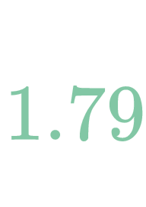

Measures of Dispersion - Standard Deviation
$$x$$ | $$x−\overline{x}$$ | $${\left(x−\overline{x}\right)}^{2}$$
0 | -2 | 4
1 | -1 | 1
1 | -1 | 1
2 | 0 | 0
3 | 1 | 1
5 | 3 | 9
X̅ = 2

Slide 67
Example
At a bike sales shop, sales reps are paid commission on every bike that he or she sells. You ask the manager what a typical sales rep is paid. The manager says the sales reps are paid a weekly commission of $2000 on average.
Notes:
Fighters: F-22(Raptor), 16(Falcon), 35(Lightning), 18(Hornet), 15(Eagle)

Slide 68
Example
$50, $50, $450, $500, $950, $1000, $11000
Range: $10950
Interquartile Range: $950
Standard Deviation: $3990

Slide 69
Which is best?
Range
Pros: 1. Easy to calculate
Cons: 1. Doesn’t use all the information 2. Sensitive to extreme values 3. Min and max are more useful

Slide 70
Which is best?
Interquartile Range
Pros: 1. Good for ordered data 2. Not susceptible to extreme values 3. More stable than range
Cons: 1. Doesn’t use all the information 2. Harder to calculate and understand

Slide 71
Which is best?
Standard Deviation
Pros:
1. Uses all the data values 2. Useful in statistical methods and inference
Cons: 1. Susceptible to extreme values 2. Hard to calculate manually

Slide 72
So what?
Use both measures to describe data
One does not tell you enough

